Slide 1

__ChatSpace__
The Space to Chat

Slide 2

Description
Chatspace functions similar to Discord or Slack.
We have a landing page supporting login functionality with unique users.
Once the user is logged in, there’s channels for a variety of topics, each with its’ own unique message board.

Slide 3

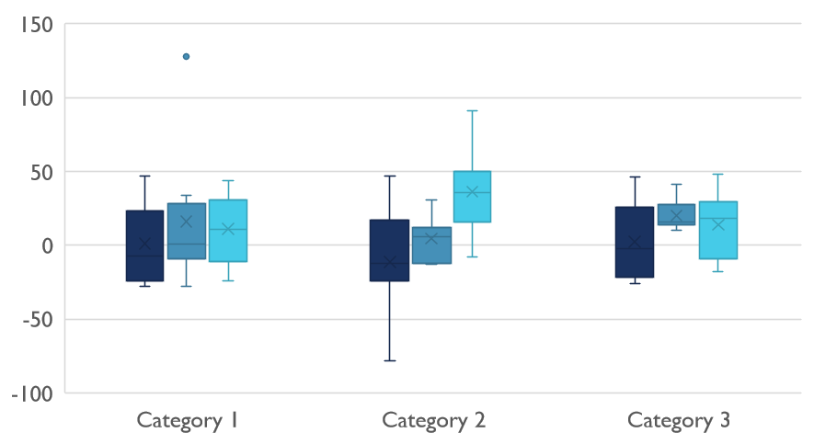
Motivation
Our goal was to make a fun, easy to use app that attracts a wide range of demographics. Whether you like fixing cars, cooking, or you’re a gamer, you can use Chatspace to fill your personal tastes.

Slide 4
Results
We have an online app that allows users to choose from or create their own channel to enter and send messages back and fourth.
It also offers a fun random meme generator!

Slide 5
Team Efforts
Our team goal was take on tasks that we felt strongest in first, then assist each other in troublesome areas.
Brady- Accountable for creating the Sequelize database structure and correspondence between channel and message table data.
Charles- Tasked with implementation of our out of class tech. We used a meme API, which allows users to post random memes to the message board.
Ashlie- Responsible for front UI/UX Design and managing implementation of features related to the login page.

Slide 6

Challenges
Whew Buddy!
The most difficult part of the project was tackling the channel/messages database table.
Ex. The COD channel should only display messages related to COD, not other channels such as Minecraft.
There were issues within handlebars when attempting to use unique styling for both the landing and secondary pages. Handlebars forced the landing page styling to continue to the secondary messages page which is not what we wanted. There was also trouble with the login database accepting usernames.

Slide 7
Improvements
A future version would feature a landing page request for the handle or username, as well as a password. There would be a better look for certain buttons, the capability to post video snippets (such as gameplay) and the chance to live chat via video.
Given more time, we would like to have added additional functionality such as including support for creation of more channels, with default or user choice of styling themes within the app.

Slide 8

Thank You
From team abc

